Slide 1
STA/BST 222 Survival Analysis Introduction
Lihong Qi
Division of Biostatistics
Department of Public Health Sciences
School of Medicine
Oct. 6, 2020

Slide 2
How to contact me
Email is best: lhqi@ucdavis.edu
Phone: 530-754-9234
Office hour: email for an appointment

Slide 3
How to contact TA
Xiner Zhou
Email: xezhou@ucdavis.edu
Office hours: 7:00pm – 8:00pm, Thursdays
Lab: 6:10-7:00 pm, Thursdays
For both Lab and OH, please use the zoom link with passcode: survival https://ucdstats.zoom.us/j/9681353237?pwd=ZzhLRHlhNG92bHFUaHkwM0Fib1pqQT09 Meeting ID: 968 135 3237

Slide 4
Outline
Introduction
Defining survival outcome variables
Censoring and truncation
Summary & exercise
Homework

Slide 5
Why important?
Observed time, failure times, censoring times
The design of survival experiments involving censoring and truncation needs to be carefully considered when constructing likelihood functions.
A critical assumption is that the lifetimes/failure times/event times and censoring times are independent.

Slide 6
Survival Outcome Variables
What is the event?
Where is the time origin?
What is the time scale?
They depend on the research of interest and study design.

Slide 7
Define the outcome variables
What is the event?
Most of time is straightforward
Sometimes it is based on some cutoff point (e.g. weight control)
This event may be
death, the appearance of a tumor, the development of some disease, recurrence of a disease, equipment breakdown, cessation of breast feeding
remission after some treatment, conception, cessation of smoking

Slide 8
Time origin
The time origin (time zero) is the point at which follow-up time starts, ie., the time at which subjects are considered at-risk for the outcome of interest.
A variety of time origins are largely determined by study design, each having associated benefits and drawbacks. Examples:
the start of the study (i.e., at enrollment); baseline age and baseline time
determined by a defining characteristic, eg
In a clinical trial, the time origin is usually considered the time of randomization or treatment or diagnosis.
An exposure
birth and calendar year
https://www.publichealth.columbia.edu/research/population-health-methods/time-event-data-analysis

Slide 9
Time origin
It is important to define (and record) the time origin so that the follow up time can be accurately measured/calculated.

Slide 10
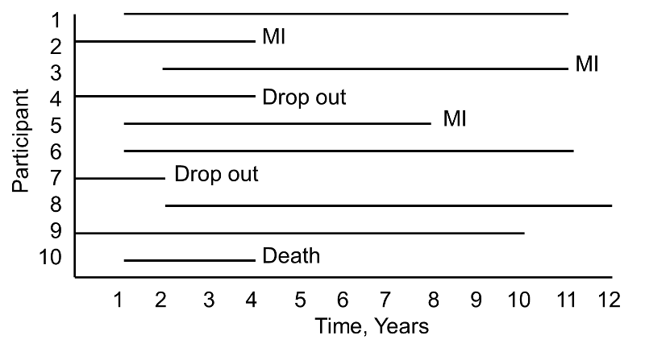
Example
A small prospective study follows 10 participants for the development of myocardial infarction (MI, or heart attack) over 10 years.
Participants are recruited into the study over a period of two years and are followed for up to 10 years.
Note: staggered entry (not every patient enters the study on the first day)
https://sphweb.bumc.bu.edu/otlt/MPH-Modules/BS/BS704_Survival/BS704_Survival_print.html

Slide 11
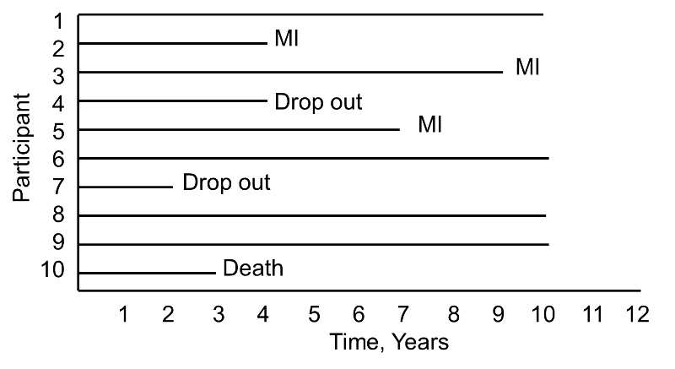
Example
Survival time starting at a common time zero (i.e., as if all participants enrolled in the study at the same time).

Slide 12
Choice of Time Scale
Scale | Origin | Comment
On study time | Dx or Tx or randomization | Clinical Trials
On study time | First exposure or enrollment | Epidemiology
Age | Birth | Epidemiology

Slide 13
Population Mortality
Event: death
Time: age at death
Time origin: date of birth
Time scale: age (years)

Slide 14
Toxin Effect on Lung Cancer Risk
Occupational exposure at nickel refinery
Event: death from lung cancer
Time: first employed to death from LC
Origin: first exposure
Employment at refinery
Scale : years since first exposure

Slide 15
A Women Health Initiative DM study
Aim: Type 2 diabetes is more prevalent in African-Americans (AFAs) and Hispanic-Americans (HAs) than in European-Americans. We assessed whether continental admixture was correlated with diabetes risk in these high-risk groups.
Method: We estimated the proportion of sub-Saharan African (AFR), Amerindian (AMI) and European admixture using 92 ancestry-informative marker genotypes in 16,476 AFA and HA women from the Women's Health Initiative (WHI). Cox regression models were used to examine the association between admixture and diabetes risk, with and without accounting for socioeconomic status (SES) and adiposity measurements.
Reference: L. Qi, R. Nassir, R. Kosoy, L. Garcia, J. D. Curb, L. Tinker, B. V. Howard, J. Robbins, M. F. Seldin. Relationship between diabetes risk and admixture in postmenopausal African-American and Hispanic-American women. Diabetologia. 2012 May; 55(5): 1329–1337.

Slide 16
Outcomes
We considered a time-to-event outcome which was time-to-diabetes for diabetic participants and censoring time for non-diabetic participants as of September 2005.
A participant was diabetic if she had been treated for diabetes at baseline or during follow-up as of September 2005.
A woman had diabetes at baseline if she reported at study entry that she had received a physician diagnosis of sugar diabetes when not pregnant and received glucose-lowering medications. Age range when a participant was first told to have non-pregnancy-related diabetes was reported as <21, 21–29, 30– 39, 40–49, 50–59, 60–69 or 70 years or older. We used the middle point of the corresponding age ranges (e.g. 45 for the range 40–49) as time to event for the participants with baseline diabetes.

Slide 17
Outcomes, cont
A participant was diabetic if she had been treated for diabetes at baseline or during follow-up as of September 2005.
Participants had diabetes during follow-up if they reported a new physician diagnosis of diabetes treated with glucose-lowering agents. Assuming birth as time 0, time to diabetes was considered as the event time for participants with diabetes, and for participants who did not have diabetes as of September 2005, their last time of follow-up or death time was the censoring time.
What is the event?
Treated diabetes
Time origin:
birth
Time scale:
age

Slide 18
KM 1.2: Effect of 6-MP on children with acute leukemia
A randomized clinical trial: a drug 6-mercaptopurine (6-MP) vs a placebo.
42 patients were 1-1 matched by their remission status: a complete or partial remission
Patients were followed until their leukemia returned (relapse) or until the end of the study (in months)
Question:
What’s the event?
Did every child have the event?
What is the time origin
What is the time scale

Slide 19
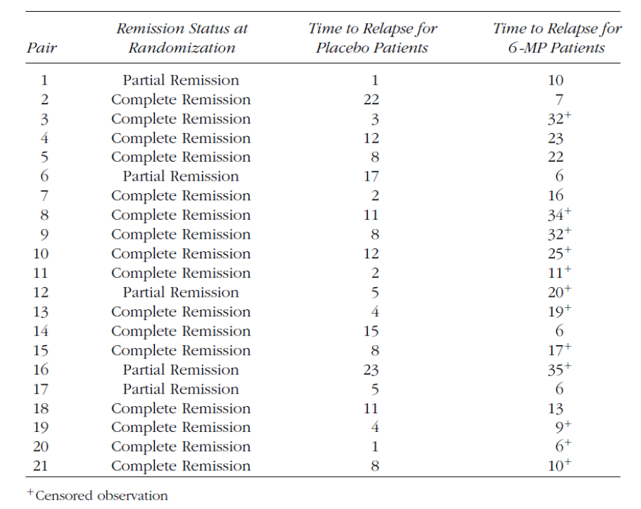
KM 1.2: Effect of 6-MP on children with acute leukemia

Slide 20
KM 1.2: Effect of 6-MP on children with acute leukemia
Question:
What’s the event?
leukemia returned/relapse
Did every child have the event?
no
What is the time origin
randomization
What is the time scale
on study

Slide 21
Volume of Air a Balloon Can Tolerate
Event: balloon bursts
Time: volume of air infused when the balloon bursts
Origin: 0 ml of air in the balloon

Slide 22
Blood Pressure Control
Hypertensive patients
Time: dose intensity
Event: blood pressure under control (e.g. SBP <125)
Origin: start of treatment

Slide 23
Remarks
Most of time events are well defined in a dataset.
Sometimes events are not well outlined and depend on the research questions, especially for social behavioral studies.
“Time” is not necessary time.
What the event is could affect how the study is designed, e.g. study population and recruitment.

Slide 24
Censoring and truncation

Slide 25
Complications of survival data
Censoring: A censored observation arises when the exact failure time is unknown, but is known to occur only in a certain period of time
Truncation: A truncated observation is one which is unobservable due to a selection process inherent in the study design.
individuals enter the study only if they survive a sufficient length of time or individuals are included in the study only if the event has occurred by a given date.

Slide 26
Typical Censoring Mechanisms
Right censoring
Type I censoring
Type II censoring
Random censoring
Left censoring
Interval censoring

Slide 27
Right Censoring
Observation begins at the defined time origin and ceases before the event of interest is realized.
The survival time is only known to exceed a certain value.
Incomplete nature of the observation occurs in the right tail of the time axis.

Slide 28
Notation
Ci = the censor time of subject i (or say potential observation duration).

Slide 29
Right Censoring: Type I
The censor times, Cis, are pre-specified and fixed.
The number of censor cases is random.
The event of interest is observed only if it occurs prior to some prespecified time.

Slide 30
Example: Diet-tumor Study
Research goal: interested in the relationship between diet and the development of tumors.
2 diet groups: low-fat, saturated-fat
30 rats per group
Same amount of tumor cells were injected into a foot pad of each rat, and the tumor-free times of the rats were recorded.
The study was terminated after 200 days.

Slide 31
Example: Diet-tumor Study
Tumor-free times (days) for the low-fat group are as follows:
140, 177, 50, 65, 86, 153, 181, 191, 77, 84, 87, 56, 66, 73, 119, 140
and 200+ for the other 14 rats.
“+” denotes a censored observation.
Ques: What are Cis?

Slide 32
Example: MI Study
Subjects were enrolled from 1/1/1989 to 12/31/1991.
The study ended on 12/31/1995.
The event of interest is death due to MI.
Ques: What are Cis?
What is the time origin? Time scale?

Slide 33
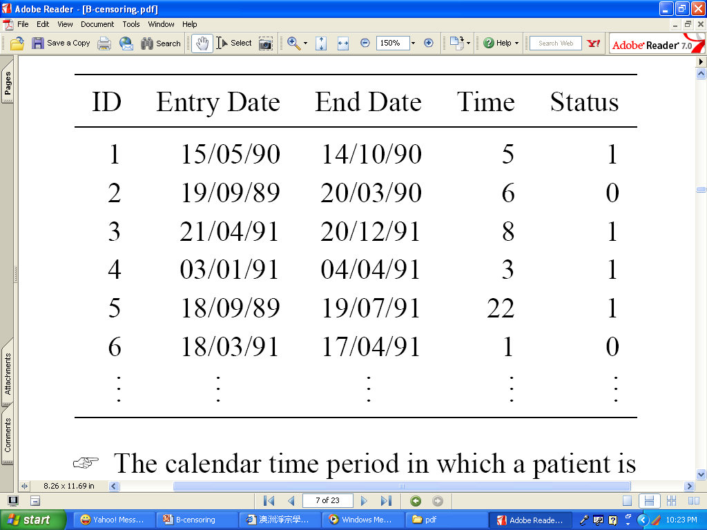
Example: MI Study

Slide 34
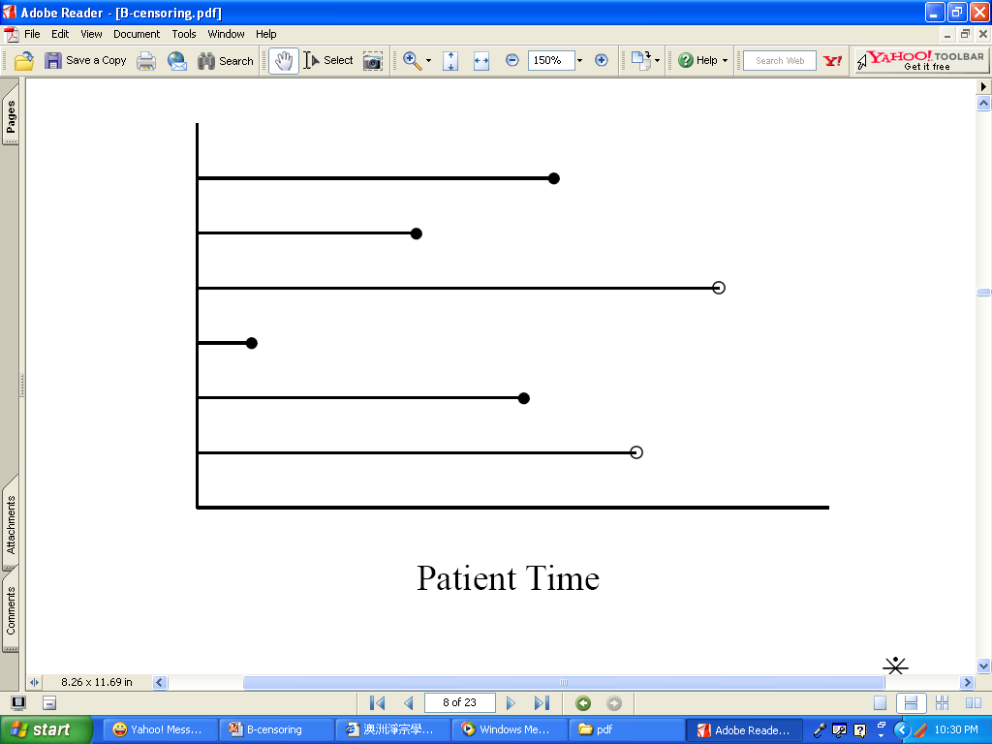
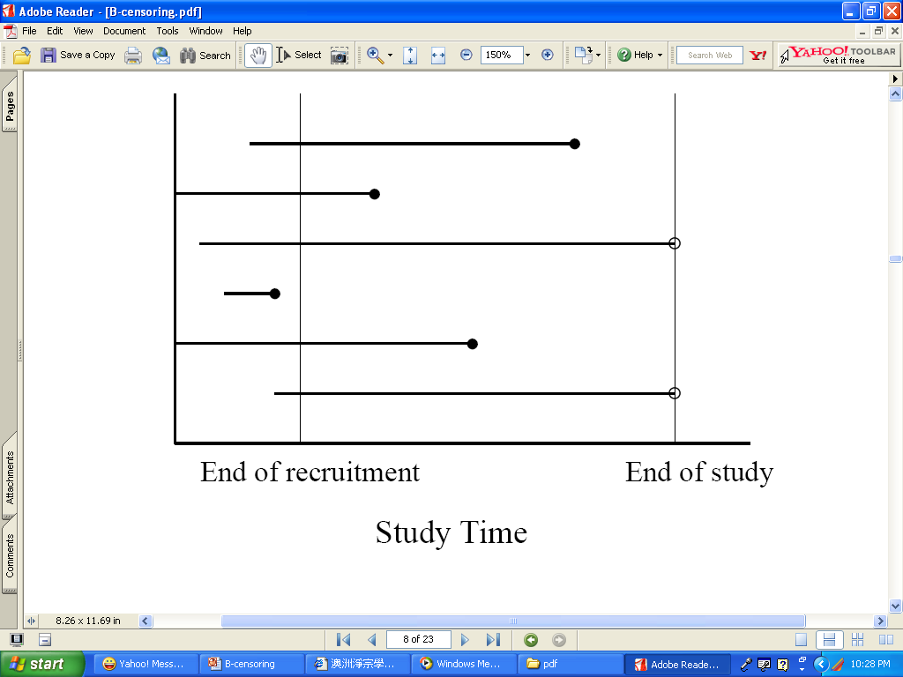
calendar time period
the length of time period that a patient spends in the study

Slide 35
Right Censoring: Progressive Type I
Progressive Type I censoring: Individuals enter the study at the same time but can have different, pre-specified censoring times.
a pre-fixed number of live test units are continuously removed during the experiment at the end of each pre-specified time interval
Allows for the removal of items at various points during experimentation, and has also been called multi-censoring or multi-stage censoring

Slide 36
Example: a mouse study
In a large mouse study, mice were fed a particular dose of a carcinogen to assess the effect of the carcinogen on survival.
Mice were followed from the beginning of the experiment until death or until a prespecified censoring time was reached.
Two prespecified censoring times were scheduled, one at 42 weeks and the final one at 104 weeks when all those still alive were sacrificed (censored).

Slide 37
Right Censoring: Type II
Arises when n subjects start on study at the same time, with the study terminating once r failures have been observed, where r is some pre-determined integer (r<n).
Experiments involving type II censoring are often used in testing of equipment life.
Censor times are random but the number of censored cases is not.

Slide 38
Example
A life test of aircraft components cannot wait until all components have failed.
The test was terminated at the 10th failure out of 12 test items. The 12 observed times (in days) are: 22, 50, 88, 100, 132, 154, 176, 250, 280, 300, 300+, 300+.
Qest: what are the Cis?

Slide 39
Right Censoring: Progressive Type II
Progressive type II censoring
Remove some items when certain number of failures observed
In Type I progressive censoring: the censoring times are predetermined and fixed
In Type II progressive censoring, the censoring times are random times at a predetermined number of events has occurred (r is fixed).
Progressive censoring, also called multi-censoring or multi-stage censoring, allows for the removal of items at various points during experimentation.

Slide 40
Right Censoring: Competing risks (random)
Arises when other competing events cause subjects to be removed from the study. Examples:
Death in remission for bone marrow transplant patients competes with disease relapse.
A patient can die from breast cancer or from stroke, but he cannot die from both
Random censoring: a special case of competing risk censoring.
The censoring times are random and the number of censored cases is also random.

Slide 41
Right Censoring: Random
The censoring times Ci are random variables assumed to be independent of each other and of the survival times.
In many studies, the censoring scheme is a combination of random and Type I censoring.
E.g. some patients are randomly censored when they move from the study location for reasons unrelated to the event of interest, whereas others are Type I censored when the fixed study period ends.

Slide 42
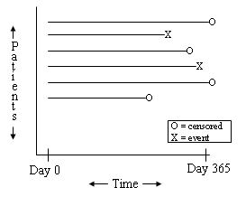
Example
https://online.stat.psu.edu/stat509/node/33/

Slide 43
Left Censoring
Arises when the event of interest has already occurred for the individual before observation time.
The survival time is only known to be less than a certain value.
Incomplete nature of the observation occurs in the left tail of the time axis.

Slide 44
Left Censoring
Age smoking starts
Data from interviews of 12 year olds
12 year old reports regular smoking
Do not remember when they started smoking regularly
Notes:
Observed time larger than survival time; avoid with strict entry criteria

Slide 45
Interval Censoring
A more general type of censoring occurs when failure is known to occur only within an interval.
A generalization of left and right censoring.
Not the focus of this course!

Slide 46
Example: Cancer Recurrence
Survival (failure) time is the time to recurrence of breast cancer, following surgical removal of primary tumor.
After surgery, patients are examined every 6 months to determine if cancer has recurred.

Slide 47
Reasons of Censoring
Lost to follow-up
Withdraw from the study
Study is terminated
Competing events

Slide 48
Why are censored data important?
Contain partial information of the event of interest
Sample size (efficiency) issues
Bias issues
What is the key assumption of censoring?
Independence: the reason that a subject is censored has nothing to do with the event of interest.

Slide 49
Exercise
1. Event: having baby. Now suppose you survey some women in your study at the 250-day mark, but they already had their babies. You know they had their babies before 250 days, but don’t know exactly when.
2. Event: recovery from treatment. Now suppose you survey some patients in your study at the end of 10 day of treatment, 1/2 patients were recovered by the end of the study, 2 dropped out of the study.
3. Event: DM. Now suppose you send out annual questionnaire to participants asking whether they were told by their doctors that they had diabetes in the past year.
Ques: What type of censoring in 1-3?

Slide 50
Truncation
Truncation: A truncated observation is one which is unobservable due to a selection process inherent in the study design.
individuals enter the study only if they survive a sufficient length of time or individuals are included in the study only if the event has occurred by a given date.
For truncated data, only subjects who satisfy the condition are observed by the investigator.
The condition is usually associated with a truncation time
Left and right truncation

Slide 51
Left Truncation
Arises when only individuals who have not experienced the event of interest before truncation time are included in the sample.

Slide 52
Example: Channing House KM 1.16
Channing House is a retirement center in Palo Alto, CA
All the residence were covered by a health care program provided by the center
Ages at death of 462 individuals who were in residence during Jan 1964 to July 1975 are recorded
Ages at which individuals entered the retirement center are also recorded
Left truncation
an individual must survive to a sufficient age to enter the retirement center.
Why left truncation matters?

Slide 53
Example: astronomical data
With a given telescope, we can only detect a very distant stellar object which is brighter than some limiting flux — the object is left-truncate if it lies beyond detection by our telescope – we cannot tell if the object is even there if we cannot see it.

Slide 54
Right Truncation
Arises when only individuals who have experienced the event of interest are included in the sample.

Slide 55
Example: AIDS
Only those who developed AIDS were asked for their infection dates
Data: infection and induction times for 258 adults who were infected with AIDS virus and developed AIDS by 6/30/1986
Time in years infected by AIDS virus (from 4/1/1978)
Waiting time to the development of AIDS (from the date of infection)
Ques: What is the time and condition of truncation?

Slide 56
Summary
Identify/Define time origin and time scale
Identify censoring mechanism: event time not observed
Right, left, interval
Type I, type II, random
Identify truncation: not in the data
Left, right

Slide 57
Censoring vs. Truncation
Censoring is about leaving the study: in the study without observing the exact event time
Truncation is about entering the study: not in the study if truncated
The main difference: censored subjects are included in the analysis but not truncated subjects.

Slide 58
Exercise: the WHI Diet and Breast Cancer study
Patients and Methods The trial randomly assigned 48,835 postmenopausal women with normal mammograms and without prior breast cancer from 1993 to 1998 at 40 US clinical centers to a dietary intervention with goals of a reduction of fat intake to 20% of energy and an increased intake of fruits, vegetables, and grains (40%; n = 19,541) or to a usual diet comparison (60%; n = 29,294).
Ques: What is the time and condition of truncation?
Chlebowski RT, Aragaki AK, Anderson GL, Thomson CA, Manson JE, Simon MS, Howard BV, Rohan TE, Snetselar L, Lane D, Barrington W, Vitolins MZ, Womack C, Qi L, Hou L, Thomas F, Prentice RL. Low-Fat Dietary Pattern and Breast Cancer Mortality in the Women's Health Initiative Randomized Controlled Trial. J Clin Oncol. 2017 Sep 1;35(25):2919-2926.

Slide 59
Exercise: the WHI DM study
The WHI is the largest US health study in a multiethnic group of postmenopausal women aged 50-79 years, and consists of four randomised controlled clinical trials and an observational study. This study involves 40 clinical centres and recruited over 160,000 women between 1993 and 1998.
We considered a time-to-event outcome which was time-to-diabetes for diabetic participants and censoring time for non-diabetic participants as of September 2005.
A woman had diabetes at baseline if she reported at study entry that she had received a physician diagnosis of sugar diabetes when not pregnant and received glucose-lowering medications. Age range when a participant was first told to have non-pregnancy-related diabetes was reported as <21, 21–29, 30– 39, 40–49, 50–59, 60–69 or 70 years or older.
Ques: What is the time and condition of censoring/truncation?

Slide 60
Exercise: the WHI DM study
A participant was diabetic if she had been treated for diabetes at baseline or during follow-up as of September 2005.
Participants had diabetes during follow-up if they reported a new physician diagnosis of diabetes treated with glucose-lowering agents. Assuming birth as time 0, time to diabetes was considered as the event time for participants with diabetes, and for participants who did not have diabetes as of September 2005, their last time of follow-up or death time was the censoring time.
Ques: What is the time and condition of censoring/truncation?

Slide 61
Why important
Observed time, failure times, censoring times
The design of survival experiments involving censoring and truncation needs to be carefully considered when constructing likelihood functions.
A critical assumption is that the lifetimes/failure times/event times and censoring times are independent.

Slide 62
Homework 1
Reading the textbook KM, Chapter 3.1-3.4
Answer the following questions:
What are the new things you’ve learned, or new understanding of something you knew before?
How would you apply them to your research/project?
Prepare for group discussions in next class.
Reading the textbook KM, Chapter 1, and identify examples for different censoring and truncation mechanisms. Due by Thursday.
Think about and write down your specific goals for this course, develop a specific and practical plan to achieve your goals. Be specific. Due by Thursday.

